Slide 1
From scanned answer booklets
to one Markdown document per student
How the system turns a stack of handwritten pages into structured text
Major Project Review
Department of Computer Science & Engineering
B.M.S. College of Engineering, Bangalore
Corpus: Computer Networks internal assessments, CIE 1–3
Notes:
Scope: dataset collection through to the assembled booklet document. Marking is a later stage and is not covered.

Slide 2
What the system does
One sentence, then the rest of the deck is how.
INPUT
A folder of scanned pages
photographed, skewed, in colour
OUTPUT
student_19_cie_1 / booklet.md
questions in order · answers stitched across pages · diagrams embedded
• The pages arrive as images. Nothing in them can be searched, counted, copied or marked automatically.
• The output is plain text with structure — which question each answer belongs to, what the student wrote, and where their drawings are.
• Everything in between is done by the system with no human transcription, and with no training data: the reading model is used exactly as published.
2
Notes:
Emphasise: zero labelled training data was produced for the reading stage.

Slide 3
Step 0 — Collecting the dataset
Where the pages came from, and the rules we set before touching them.
• Answer booklets from three Computer Networks internal assessments were scanned page by page using a phone scanner app, one folder per student per exam.
• Naming was fixed at the source, because everything downstream depends on it: student_NN / cie_C / page_PP.png. The student number, the exam and the page order are carried by the path itself.
• Pages were kept in their original order. Reconstruction later needs to know that page 5 follows page 4 in order to stitch an answer that runs over the break.
• Scans were deliberately not cleaned by hand. If the system cannot cope with an ordinary phone scan, it is not useful.
MP_Dataset/
student_01/ cie_1/ page_01.png page_02.png ...
cie_2/ page_01.png ...
student_02/ ...
Raw scan properties
• 1700 × 2338 pixels, colour
• Green ruled paper, blue/black ink
• Visible skew and page borders
3
Notes:
The naming convention is not cosmetic. Page order is the only signal available for stitching answers across a page break.

Slide 4
The corpus
122
booklets
1,231
pages
3
assessments
1,000
pages read so far
• A booklet is one student's answers for one assessment, so the same student appears three times — once per CIE.
• Booklets vary from 6 to 12 pages. Handwriting varies from copperplate cursive to barely legible, which is the whole difficulty of the problem.
• The pages were split into five batches for processing so that a dropped session never costs more than one batch of work.
Page 1 of every booklet is never processed
It carries the student's name, USN, signature and awarded marks. It is removed three separate times — when batches are packed, again when they are unpacked for reading, and again in the pipeline driver. One check would be enough if no stage were ever run on its own; they are, so there are three.
4
Notes:
Expect a question here. The answer is that stages are run individually during development, so a single guard is not enough.

Slide 5
The process end to end
Four things happen to every page, in this order.
1
PREPARE
Deskew, crop and
flatten the lighting
2
READ
A vision-language model
writes Markdown
3
ASSEMBLE
Group pages by question,
crop the diagrams
4
BOOKLET
One Markdown file
per booklet
Only step 2 needs a GPU. Steps 1, 3 and 4 are image processing and text handling, and run on an ordinary laptop in seconds per booklet.
• Each step writes its output to disk before the next one begins, so any step can be re-run alone and inspected.
• That also means a failure is contained: if reading goes wrong on one page, preparation does not have to be repeated.
5
Notes:
The separation is what let us re-run reading four times with different prompts without re-preparing 1,231 pages.

Slide 6
Step 1 — Preparing the page
Three corrections, all geometric or photometric. No text is read here.
• Deskew. The printed rules on the paper are straight lines of known orientation. Detecting them gives the angle the page was photographed at, and the page is rotated back by that angle.
• Crop. The paper edge is detected and every page is cut to the same frame, so a page is always 1598 × 2177 pixels. Later stages measure distances in pixels, and that only means something if the scale is fixed.
• Flatten the lighting. A phone photograph is brighter in the middle than at the edges, and ink from the reverse side shows through. Dividing the page by an estimate of its own background removes both.
rotate -> crop to detected paper edge -> divide by local background
1700 x 2338 colour ==> 1598 x 2177 greyscale
6
Notes:
Bleed-through is removed by exploiting sharpness, not brightness: reverse-side ink is blurred by the paper, so it belongs to the background estimate.

Slide 7
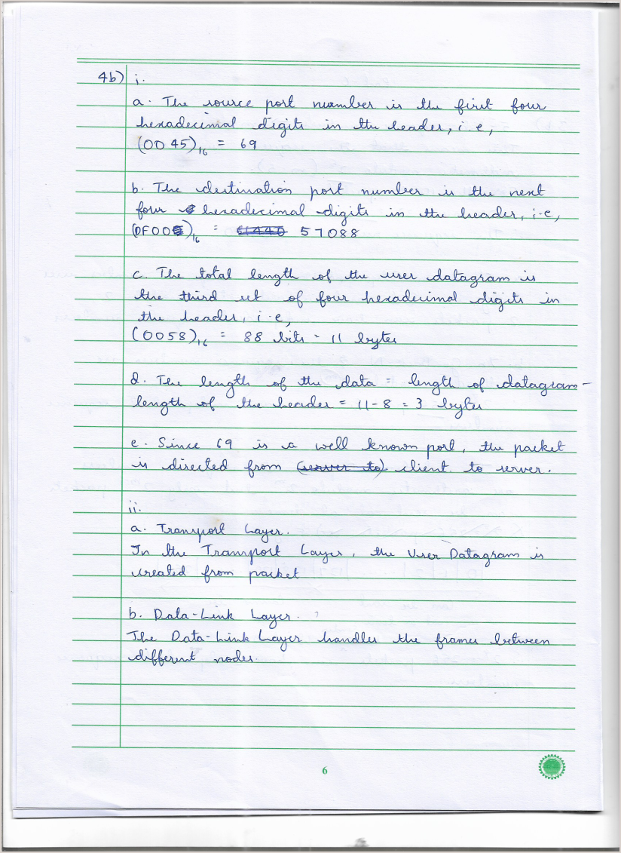
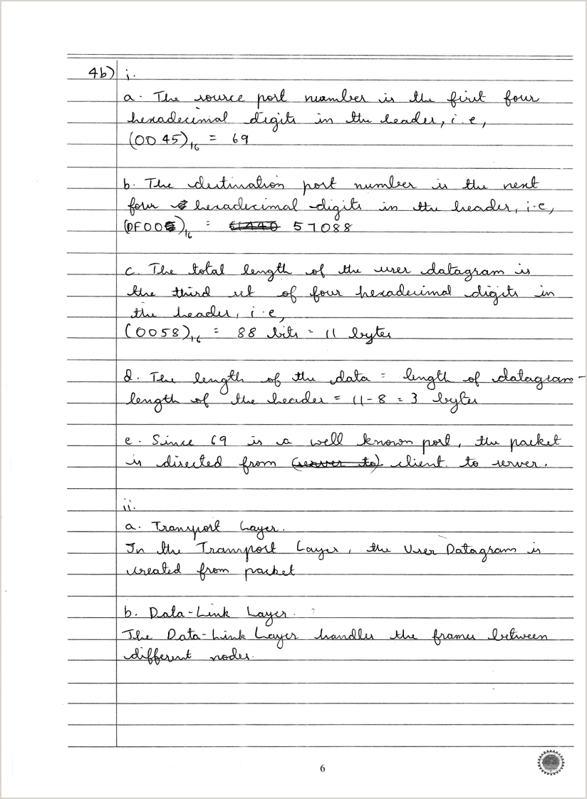
Step 1 — Before and after
The same page as scanned, and as the reading model receives it.
RAW SCAN · colour, skewed, page border, bleed-through visible
PREPARED · greyscale, square, cropped, even lighting
The ink is untouched. Nothing is sharpened, thickened or thresholded — the page is only straightened, framed and evenly lit.
7
Notes:
Point at the green rules disappearing and the faint reverse-side text vanishing between the two.

Slide 8
Why the page stays grey
The obvious next step is to turn it black and white. We do not.
• Binarising forces every pixel to ink or paper. Pencil, faint ballpoint and the thin end of a stroke all sit near the threshold, so a small change in lighting decides whether a letter survives.
• Greyscale keeps that information and lets the model weigh it. A half-tone stroke stays a half-tone stroke rather than becoming a coin toss.
• The measurable consequence: the faint diagonal strokes in hand-drawn figures survive, and those are exactly the strokes a diagram is made of.
General principle we followed throughout: never destroy information early to make a later step simpler. The later step can always be made smarter; the discarded pixels cannot be recovered.
8
Notes:
This is the single most reusable design lesson from the project.

Slide 9
Step 2 — Reading the page
A vision-language model reads the whole page at once and writes Markdown.
• The model is given the entire prepared page as an image and asked to write out what is on it. It is not shown individual lines or words.
• Context is the reason. A recogniser shown one cropped line cannot tell a question number from a stray digit. A model that can see the whole page knows “2b)” is a question number because of where it sits and what follows it.
• It runs quantised, so it fits on a free cloud GPU, and it is used exactly as published — no fine-tuning, no labelled examples.
• Output is Markdown, not plain text, so the structure the student put on the page survives into the file.
for each page:
show the model the image + a fixed instruction
it returns Markdown -> saved as s19_c1_p08.md
1 page → 1 Markdown file
reading is independent per page
9
Notes:
Per-page independence is what makes the work restartable and parallelisable.

Slide 10
What the model is asked to produce
A fixed set of conventions, so that every page comes back in the same shape.
Question numbers
become Markdown headings
### 2b)
Ordinary writing
becomes plain paragraphs
The client sends a SYN…
Mathematics
becomes inline LaTeX
$99 \bmod 32 = 3$
Ruled tables
become Markdown tables
| A | 40 | B |
Drawings
become a marker naming the figure
![diagram: ARP request]
Unreadable words
become an explicit marker
[?]
The next six slides show real pages and the exact Markdown each one produced.
10
Notes:
The [?] marker matters: the model is told to say when it cannot read something rather than guess.

Slide 11
Example 1 — Neat handwriting
NEAT
A cursive page of numbered sub-answers. This is the easy case, and it comes back almost perfectly.
Markdown produced by the model
### 4b)
i.
a. The source port number is the first four
hexadecimal digits in the header, i.e.,
(00 45)₁₆ = 69
b. The destination port number is the next four
hexadecimal digits in the header, i.e.,
(DF00)₁₆ = 57088
c. The total length of the user datagram is the
third set of four hexadecimal digits in the
header, i.e., (0058)₁₆ = 88 bits = 11 bytes
d. The length of the data = length of datagram
- length of the header = 11 - 8 = 3 bytes
e. Since 69 is a well-known port, the packet is
directed from (server to) client to server.
ii.
a. Transport Layer.
In the Transport Layer, the user Datagram is
created from packet
b. Data-Link Layer.
The Data-Link Layer handles the frames between
different nodes.
scanned page, after preparation
▪ The question label 4b) is recognised and becomes a heading
▪ Subscripts are preserved — the model wrote (0045)₁₆, not (0045)16
▪ The student's crossed-out “server to” survives as brackets rather than as struck-through text — a small loss
11

Slide 12
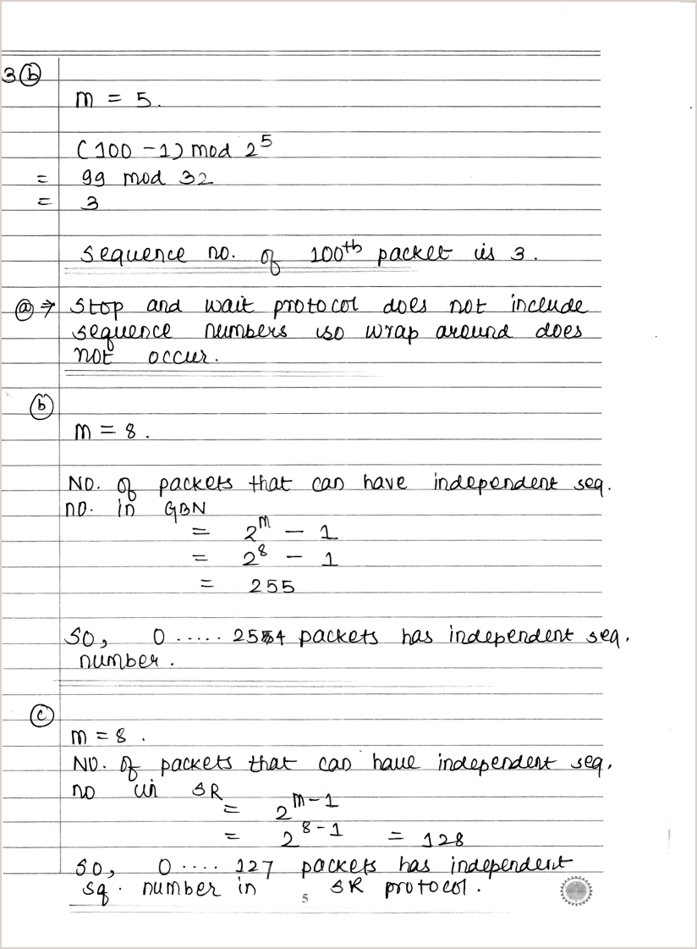
Example 2 — Mathematics
MATHS
Worked arithmetic with powers and modulo. Layout carries meaning here, so it has to be preserved.
Markdown produced by the model
### 3(b)
$m = 5.$
$(100 - 1) \mod 2^5$
$= 99 \mod 32$
$= 3$
sequence no. of 100th packet is 3.
@ $\Rightarrow$ stop and wait protocol does not
include sequence numbers so wrap around does
NOT occur.
(b)
$m = 8.$
No. of packets that can have independent seq.
no. in GBN
$= 2^m - 1$
scanned page, after preparation
▪ Superscripts become real LaTeX — 2^5, 2^m - 1 — so the arithmetic stays machine-readable
▪ The label 3(b) is a bracketed form; the parser accepts it alongside 3b, 3 b) and Q3)
12

Slide 13
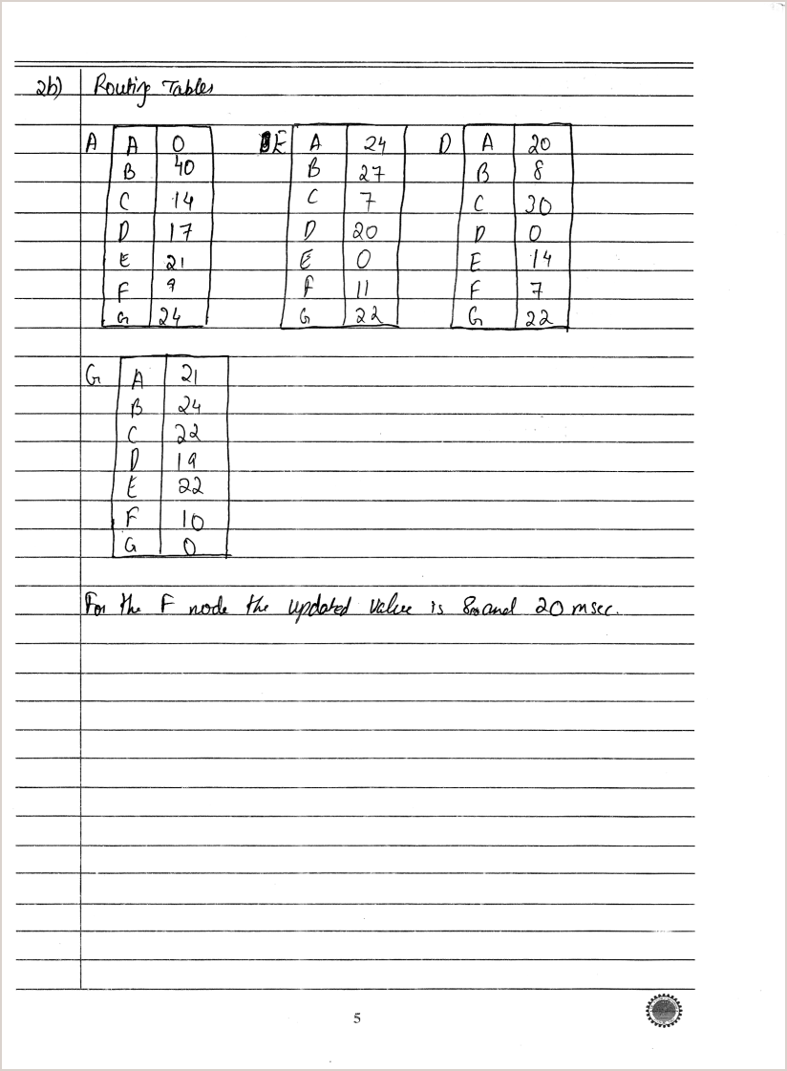
Example 3 — A hand-ruled table
TABLE
A routing table drawn with a ruler. The model reproduces the grid and admits where it could not read a cell.
Markdown produced by the model
### 2b) Routing Table
| A | A | 0 | B | E | A | 24 | D | A | 20 |
|---|---|---|---|---|---|---|---|---|---|
| B | 40 | [?] | B | 27 | C | 7 | [?] | B | 8 |
| C | 14 | [?] | C | 7 | D | 20 | [?] | C | 30 |
| D | 17 | [?] | D | 20 | E | 0 | [?] | D | 0 |
| E | 21 | [?] | E | 0 | F | 11 | [?] | E | 14 |
| F | 9 | [?] | F | 11 | G | 22 | [?] | F | 7 |
| G | 24 | [?] | G | 22 | [?] | [?] | [?] | G | 22 |
| G | A | 21 |
|---|---|---|
| B | 24 |
| C | 22 |
| D | 14 |
| E | 22 |
| F | 10 |
| G | 0 |
For the F node the updated value is 8 and 20 msc.
scanned page, after preparation
▪ Numbers are read correctly — the distance values are usable as data
▪ [?] marks cells the model could not read. It says so instead of inventing a number
▪ Four separate tables on the page are run together into two — column alignment is the weakest part of the output
13

Slide 14
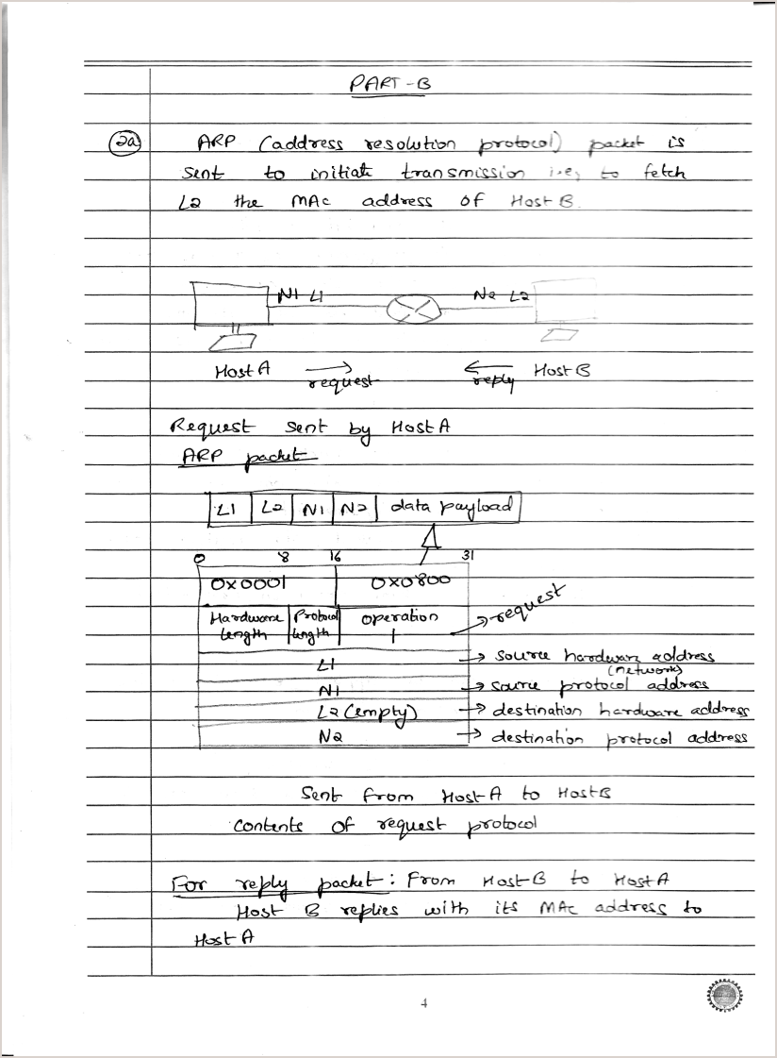
Example 4 — A page with a diagram
DIAGRAM
An ARP exchange: prose, a drawing and a packet table on one page.
Markdown produced by the model
### 2a)
ARP (address resolution protocol) packet is sent
to initiate transmission i.e. to fetch L2 the MAC
address of Host B.
![diagram: ARP packet diagram]
Host A request Host B
Request sent by Host A ARP packet
L1 L0 N1 N2 data payload
| 0x0001 | 0x0800 |
| --- | --- |
| Hardware length | Operation |
| L1 | Source hardware address (network) |
| N1 | Source protocol address |
| L2 (empty) | Destination hardware address |
| N2 | Destination protocol address |
Sent from Host A to Host B contents of request
protocol
scanned page, after preparation
▪ The ![diagram: …] marker records that a drawing sits here, and where in the reading order it belongs
▪ Prose, drawing and table on one page are each handled differently, in the order the student wrote them
14

Slide 15
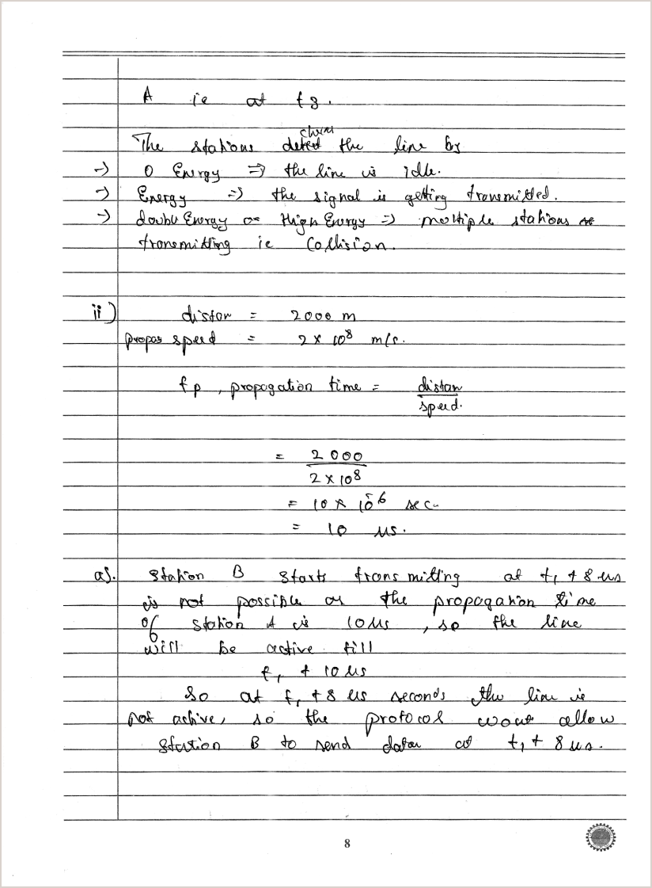
Example 5 — Difficult handwriting
MESSY
Cramped, uneven writing with worked calculation. This is the hard end of the corpus.
Markdown produced by the model
### A re at t3.
The stations detect the line by
- 0 Energy → the line is idle.
- Energy → the signal is getting transmitted.
- Low Energy or High Energy → multiple stations
are transmitting ie Collision.
ii) distance = 2000 m
propagation speed = 2 x 10^8 m/s.
f_p, propagation time = distance / speed.
= 2000 / (2 x 10^8)
= 10 x 10^-6 sec. = 10 μs.
a) Station B starts from waiting at t1 + 8 μs
It is not possible as the propagation time of
station A is 10 μs, so the line will be active
till t1 + 10 μs
scanned page, after preparation
▪ The physics is read correctly — 2000 m, 2 × 10⁸ m/s, 10 μs all survive, including the Greek mu
▪ The heading is wrong: “A re at t3” is not a question number. The page opens mid-answer, so there was none to find
15

Slide 16
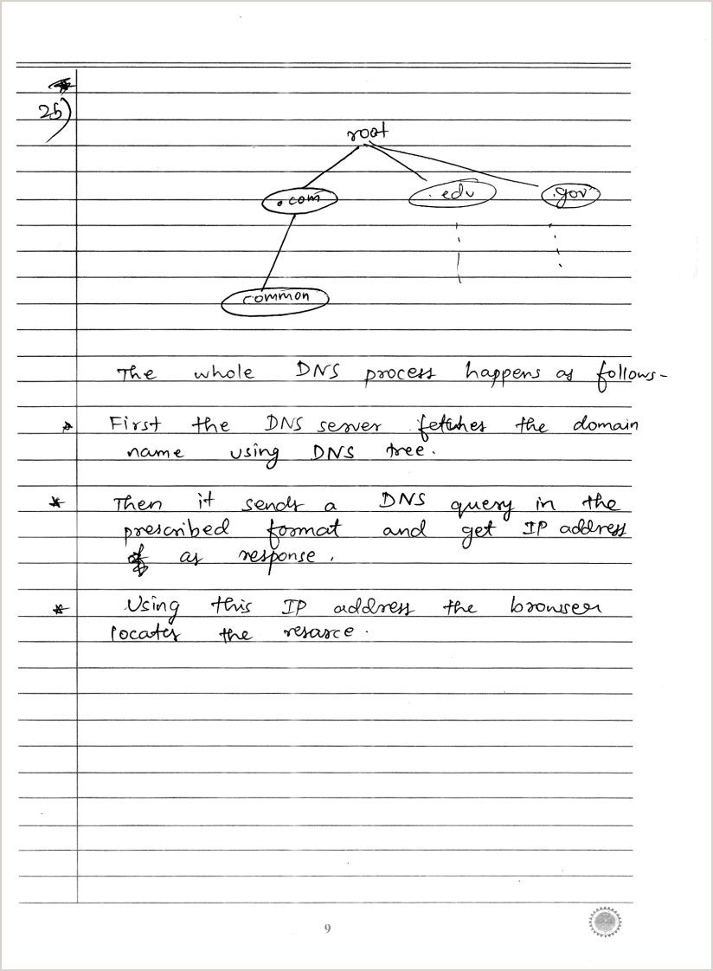
Example 6 — Where it still fails
LIMITATION
A DNS hierarchy drawn as labelled ellipses joined by lines.
Markdown produced by the model
### 2b)
| root |
| --- |
| .com |
| .edu |
| .gov |
| common |
The whole DNS process happens as follows:
* First the DNS server fetches the domain name
using DNS tree.
* Then it sends a DNS query in the prescribed
format and get IP address as response.
* Using this IP address the browser locates the
resource.
>> every node label was read correctly
>> but the tree was flattened into a list,
and no ![diagram] marker was emitted
so no picture was cropped
scanned page, after preparation
▪ All five labels are correct — root, .com, .edu, .gov, common
▪ The structure is lost: which node is the parent of which is not recoverable from the output
▪ Fix in progress: detect the drawing geometrically and embed the picture regardless of what the model called it
16

Slide 17
Step 3 — Working out which question each page answers
The pages are read independently, so they arrive as a pile of unordered answers.
• The system looks for the question label the model wrote as a heading, and uses it to file the page. The difficulty is that students write the same label many different ways.
2(b) Q3) Q(2a) Q. 4(a). 3 a) ### 2a) HTTP request
• A first version required the whole heading to be a label, so ### 2a) HTTP request was rejected. That single rule lost 79 real labels and left three booklets with no questions at all.
• The label is now separated from any title text that follows it, and bracketed and prefixed forms are all accepted.
• A page with no label is attached to the question above it, on the assumption that the answer continues. That is what stitches an answer running across a page break.
Pages filed under a question
before 96.8%
after 98.7%
Booklets with no question found
before 3
after 0
17
Notes:
The liberal regex is deliberate: a missed label costs a whole answer, a wrongly accepted one costs a heading.

Slide 18
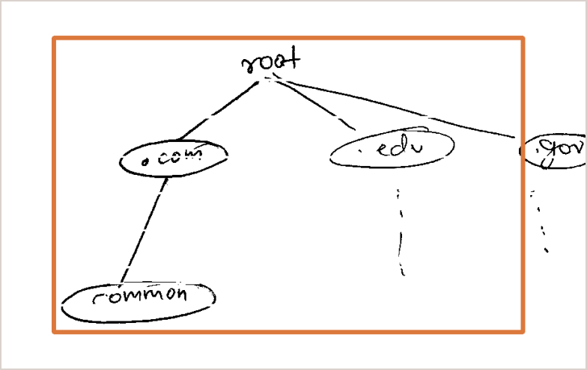
Step 3 — Putting the drawings back
A marker in the text is not a picture. The picture has to be cut out of the page.
• The model says that there is a drawing and roughly where it belongs in the reading order. It is not reliable at saying where on the page, in pixels.
• So the pixels are found by image processing instead: remove the printed rules, group the remaining ink into connected strokes, and take the bounding box of anything too large and too tall to be a line of text.
• That box is cropped from the page, saved into the booklet's figures/ folder, and linked from the Markdown at the point the drawing appeared.
![DNS hierarchy](figures/s19_c1_p08_f01.png)
• 619 figures have been cropped and embedded across the 122 booklets.
• Sparse line drawings, like the tree on the left, are the case this still misses — they break into many small pieces rather than one solid block.
rules removed, ink grouped, drawing found as one region
18
Notes:
The division of labour: the model knows reading order, image processing knows pixels. Neither can do the other's job.

Slide 19
Step 4 — Assembling the booklet
Everything collected so far is written out as a single document.
• Pages are taken in order, and each one's text is appended under the question it was filed against, so an answer split across three pages becomes one continuous answer.
• Questions are emitted in exam order — 1, 2a, 2b, 2c, then the Part C questions — not in the order the student happened to answer them.
• Every block keeps a comment recording which page it came from, so any line in the final document can be traced back to a scan.
• Where reading failed, the text is cut at the point it went wrong and the whole page image is embedded instead, with a note to read from the picture. Nothing is silently dropped.
> **Reading failed partway down this page.** Mark from the image,
> not from the text.
![s21_c3_p04 full page](figures/s21_c3_p04_page.png)
19
Notes:
59 pages carry that flag. An honest gap is usable; a silent one is not.

Slide 20
The result
One file per booklet, with its figures beside it.
# student 07 — cie 2
## 1)
<!-- s07_c2_p02 -->
1. Host A is the client and Host B is the server.
A server never initiates a request with a client. It waits
for a request from the client.
2. Missing acknowledgement number in the second segment is
8000 + 1 = 8001
## 2a)
<!-- s07_c2_p03 -->
1. Retransmission is triggered when the sender receives a
duplicate acknowledgment or when the packet timer runs out.
![handshake timeline](figures/s07_c2_p03_f01.png)
What the file guarantees
▪ Questions in exam order, sub-parts nested
▪ Answers stitched across page breaks
▪ Diagrams embedded as real images
▪ Every block traceable to its page
▪ Failures visible, never silent
student_07_cie_2/
booklet.md
figures/
20
Notes:
This is the deliverable. Marking begins from these files.

Slide 21
Where it stands
Booklets assembled
122 of 122
Remaining work
▪ The last 231 pages, which are packed and waiting on GPU time
▪ Sparse line drawings that the figure detector still misses
▪ 13 pages that open mid-answer with no label to file them under
Pages read
1,000 of 1,231
Pages filed under a question
98.7%
Booklets with no question found
0
Figures cropped and embedded
619
Pages flagged for human attention
59
A scanned booklet is now a document that can be read, searched and processed.
Automatic marking against the official schemes is the next stage, and it begins from these files.
21
Notes:
Close here.

